Slide 1
CSE 12 – Basic Data Structures and Object-Oriented Design Lecture 3
Greg Miranda and Paul Cao
Basic idea of ADT
This lecture is being recorded

Slide 2
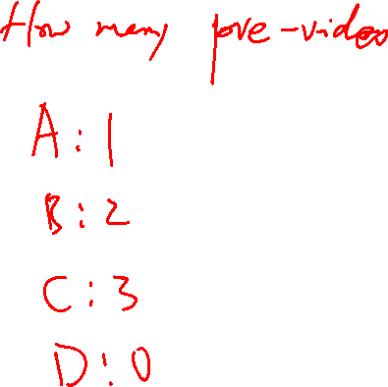
Announcements
Quiz 3 due Friday @ 9am
Survey 1 due Friday @ 11:59pm

Slide 3
Topics
Questions on Lecture 3?
Interfaces

Slide 4
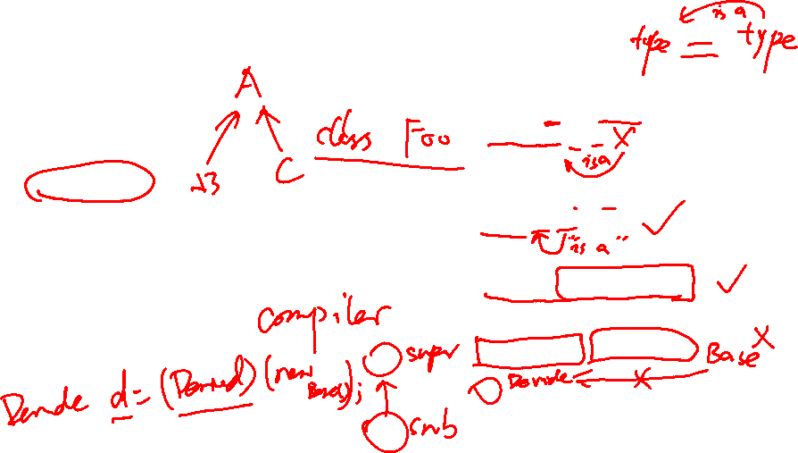
Inheritance review: Which is legal?
A:
Base b=new Base();
Derived d=b;
B:
Derived d=new Derived();
Base b=d;
C:
Base b=new Derived();
D:
Derived d=new Base();
E:
More than one of these
public class Base
{
protected int x;
}
public class Derived extends Base
{
protected int y;
}
Notes:
References of a Base class type can always point to derived class types

Slide 5
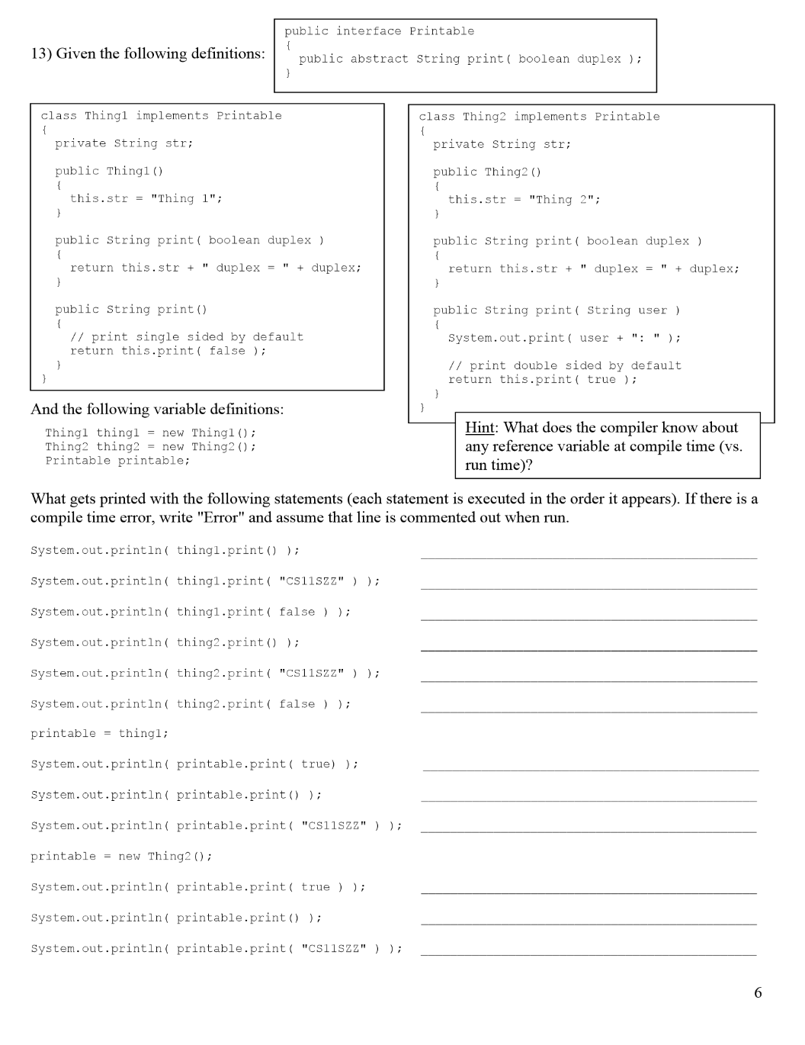

Slide 6
Key idea in designing code: Data Abstraction

Slide 7
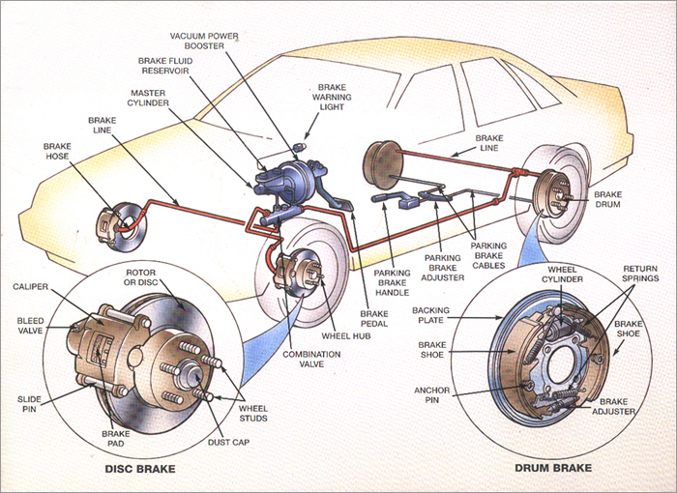
Abstraction example: car brakes

Slide 8


ADT Implementers and Users
Implementers
Users
ADT Interface:
sets the rules of interaction
“We can implement the ADT however we want!”
“We can use the ADT however we want!”

Slide 9
ADTs vs specific implementations
Sometimes the line between the abstract data type and the implementation is confusing. E.g. Car brakes
To drive my car, I rely on the abstract idea of brakes.
But for that idea to work, my car needs to have a specific implementation of brakes.
Someone needs to care about both sides!

Slide 10


ADTs vs specific implementations
It usually depends on which side you’re looking from. e.g. car brakes
In this class (and as a computer scientist) you will be the driver AND the mechanic! (i.e. the designer and the user)

Slide 11
ADTs vs APIs
ADT = "Abstract Data Type"
Defines the behaviors of a data type, but NOT its implementation
API = "Application Programming Interface"
Specifies public methods for interacting with a library or class
Does NOT reveal implementation details
Think of it as a language/code-specific ADT

Slide 12
Exercise
Please create an interface for Animals on Earth
Think what functionalities earth creatures share (dog, cat, dophin, human, etc)
Why don’t we make it an abstract class? → more freedom.

